Slide 1

Deca-Cube
Nick DeLuca

Slide 2
Table of contents
Game Summary
Main Character
Enemies
Environment
Level Design
Menus
Audio
Closing Remarks

Slide 3
Game Summary
Genre
Top-down Arcade Collect-a-thon
Objective
Collect all ten hidden items and return to start
Economy
Point based
Collectables give points, dying loses points
Faster time gives point multiplier
End Condition
Completing the objective is a victory
Dying three times is a game over

Slide 4

Main Character
Square angled 45 degrees
Simple 8-bit design
“Robert”
Easy to identify on-screen

Slide 5





Enemies
Seven different enemy types
Each has unique behaviour that shake up avoidance strategies
Enter an “enraged” state when player progresses far enough
If player takes too long, aggressiveness for all enemies increases and an eighth enemy is introduced
Charger
Gunner
Flipper
Defender

Slide 6
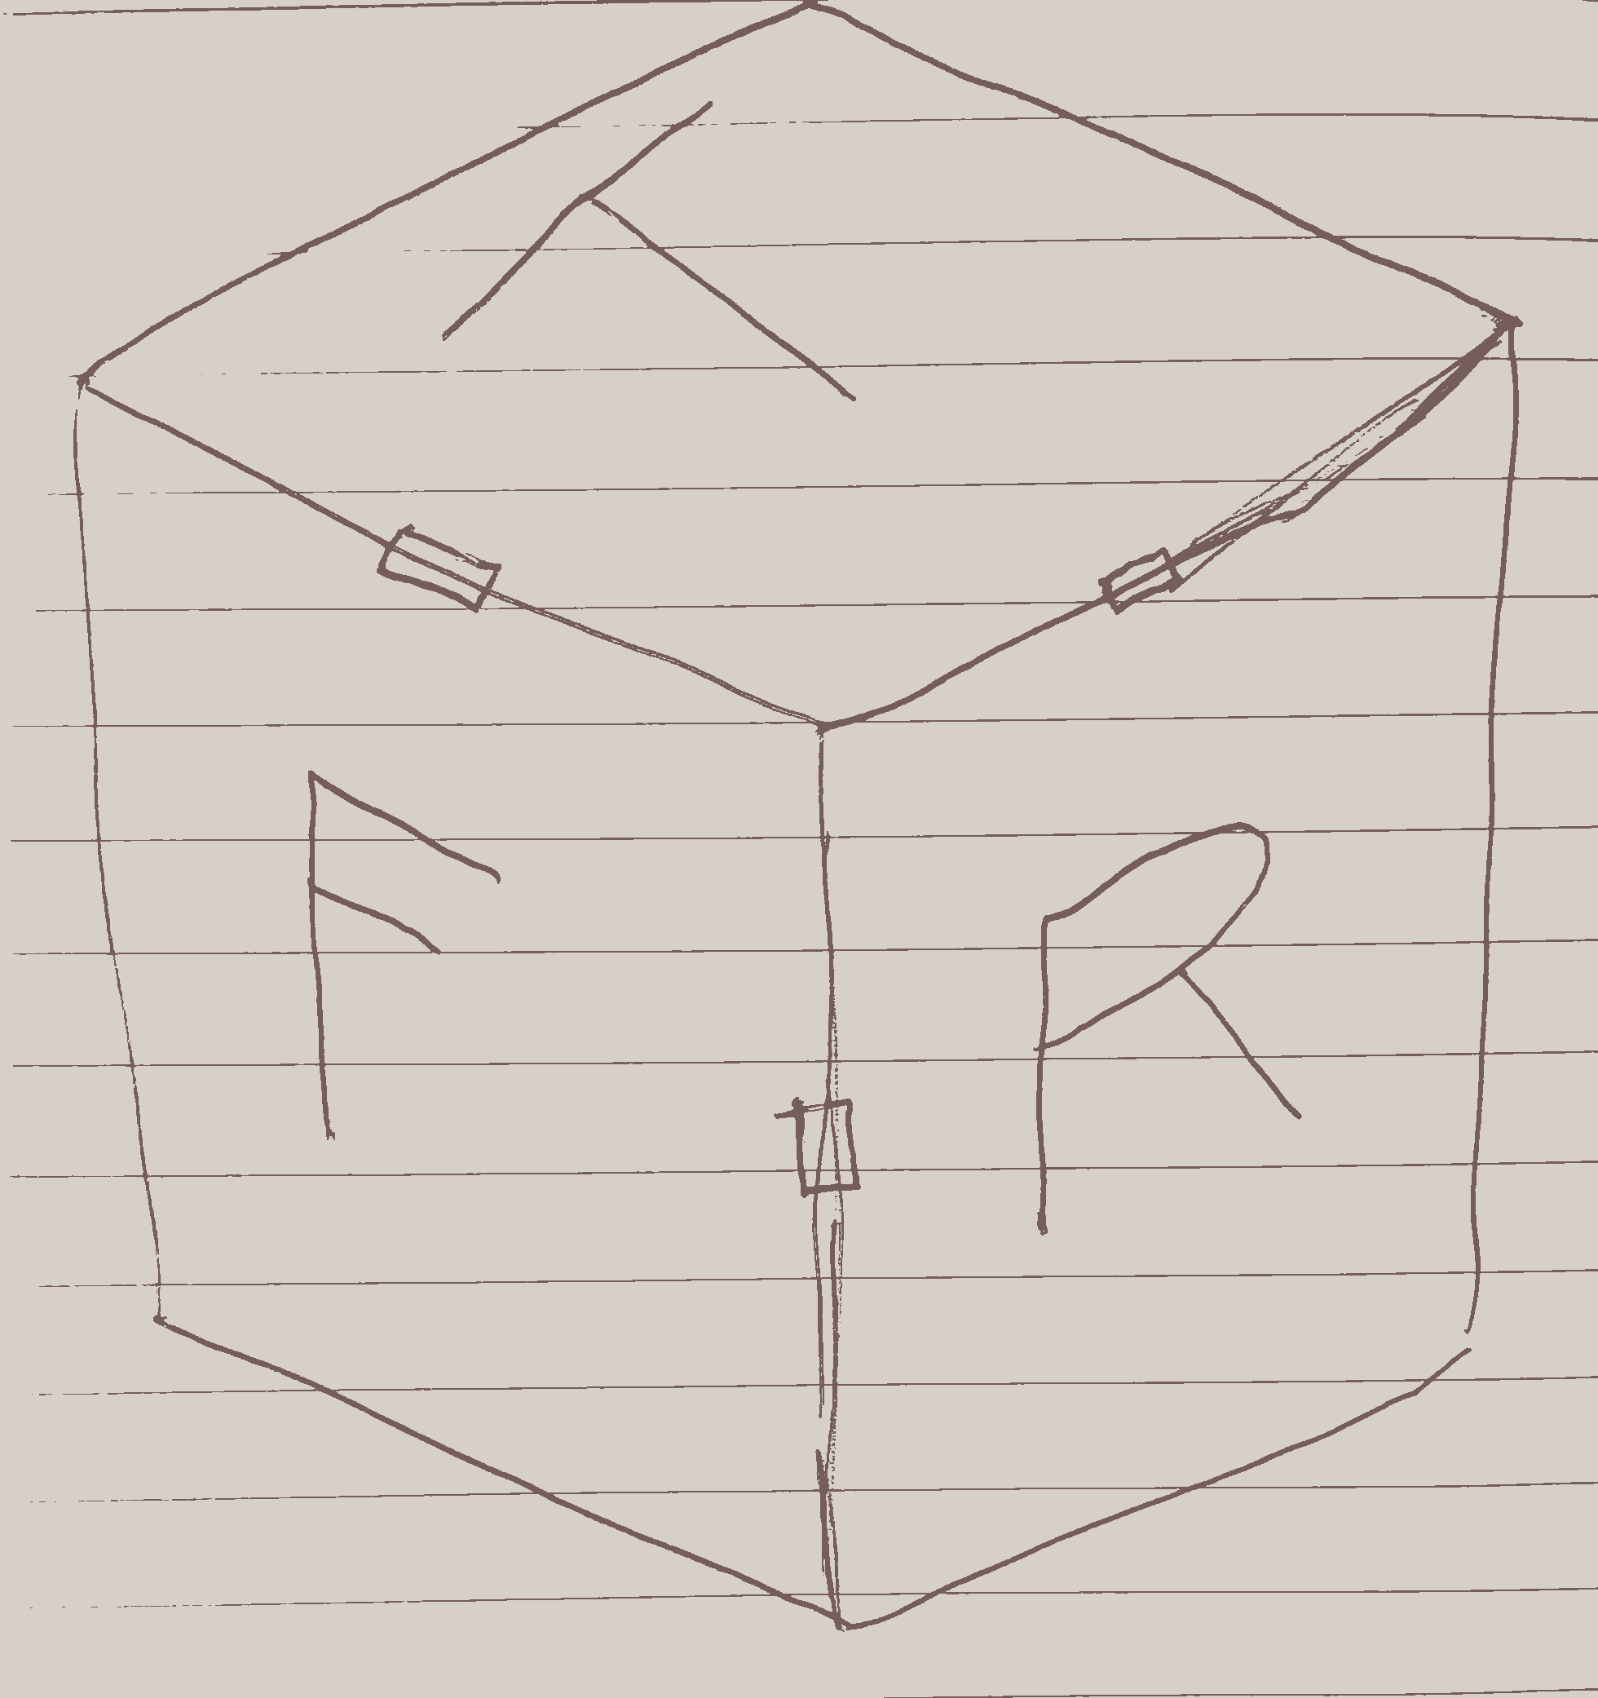
Environment
Game plays across six different mazes
Each maze is a face atop a cube
Upon changing faces, other mazes will rotate, opening new possibilities

Slide 7

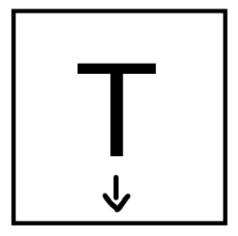
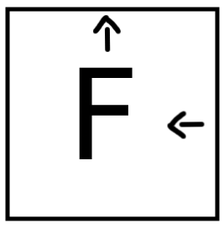
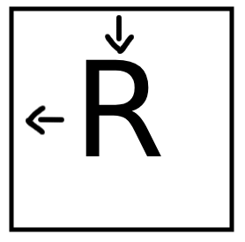
Level design
Most mazes on the cube are standalone
Some faces have paths dedicated to a certain entrance
Some collectables will only be accessible via these specific paths
Visually appealing colour scheme
Easily visible obstacles

Slide 8
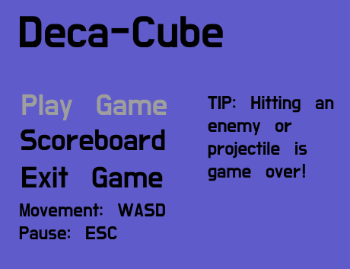
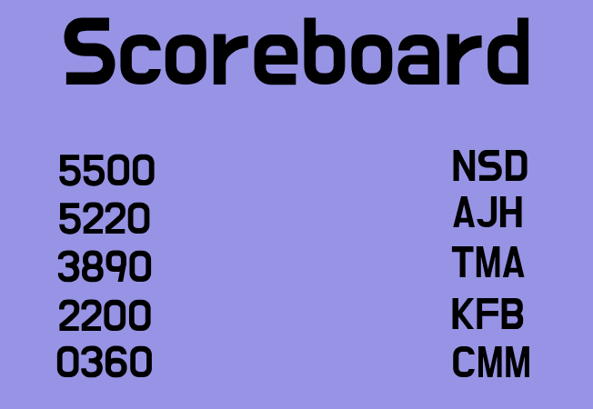
Menus
Main Menu
Shows control setup for player guidance
Has tips that change at a regular interval
Can select Scoreboard, Play Game, or Exit Game
Scoreboard
Will show top 5 scores

Slide 9

audio
All audio will be in an 8-bit sound style
Replicates the feeling of old arcade games
Gameplay and Main Menu will have separate themes
Sound effects play when different actions occur

Slide 10
Closing remarks
Deca-Cube capitalizes on arcade nostalgia
01
Plenty of replay value as players try to get the high score
02
Enemy behavioural changes and differing spawn locations means near-endless variations of game flow
03

Slide 11
Thank you for listening to my pitch

